Slide 1
Deprecating the Observer Pattern

Slide 2
Aim
Develop a reactive model in order to overcome the various deficiencies in the old observer pattern

Slide 3
Deficiencies in the observer pattern

Slide 4
Side effects
Since observers are stateless, multiple such observers are needed to simulate a state machine.
Notes:
My understanding of this is that since the machine may be in different states, need different observer for each state – like mouse down, up, move etc

Slide 5
Encapsulation
Multiple observers needed to simulate the state machine. Thus there is a need to save state in global variables, which may then be used by unrelated parts of the program.

Slide 6
Composability
The many observers are installed at different points and at different times. This does not allow for easy disposing of the observers.

Slide 7
Resource Management
Observers’ life times need to be managed carefully and explicitly. They need to be explicitly installed and uninstalled rather than being automatically garbage collected.

Slide 8
Separation of Concerns
When using the observer pattern, constructing and displaying the path are both done in the same code location. The authors argue that it is better to separate these, as in the MVC model

Slide 9
Data Consistency
Observer pattern does not guarantee data consistency. This means that some event might be emitted by a certain object, but the observer not get it due to the order in which they’re being executed.

Slide 10
Uniformity
Different observers are installed in different ways, decreasing code uniformity

Slide 11
Abstraction
The observer pattern relies on the use of a control class, which may define a far larger interface than the one needed for observing a certain source. This precludes the ability to abstract over event sources individually.

Slide 12
Semantic Distance
In this pattern, the control flow is inverted. The observed object is installing and disposing the observers, rather than the other way around. This creates a semantic distance between the programmer’s intention and the actual code.

Slide 13
What this paper presents

Slide 14
A typed higher order reactive programming library allowing for reactive programming in both a functional style and an imperative style.
Incorporate a synchronous data flow language, extended to a multi valued domain and with higher order features
A way to automatically bind the life time of observers to an enclosing object, eliminating a common source of memory leaks
An implementation that is agnostic of any host language feature

Slide 15
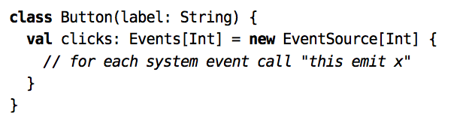
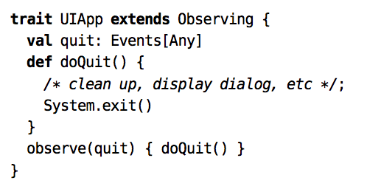
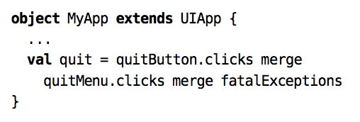
Event Streams

Slide 16
Event Streams
EventSource is a class representing a generic source
The Event streams can be abstracted over since we may as well observe any event stream, rather than just button clicks
The merge operator creates a new event stream that emits all events from the receiver and the parameter
This allows us to easily observe multiple streams without duplicating code (assuming that they are used for the same purpose
Streams are merged using the least upper bound on the type of event that they are emitting

Slide 17
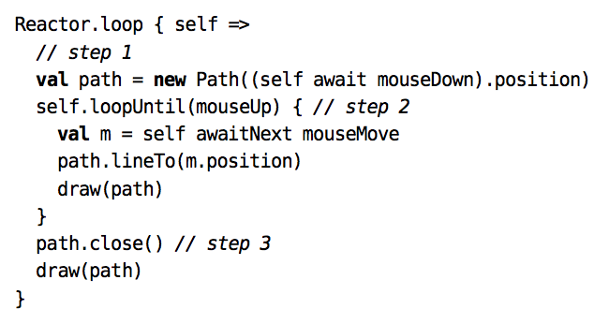
Reactors
Do not have inversion of control
Await
Returns immediately if the stream is emitting
AwaitNext
Suspends first, then returns when the stream emits
Pause
Suspends current reactor until all pending messages having been propagated
LoopUntil loops over the body until the given stream emits
This reduces semantic distance as it avoids inversion of control
Eliminates need to dispose of intermediate observers – loopUntil takes care of that
The whole drag behaviour can be disposed by a single call to Reactor.dispose() – even though there are multiple observers

Slide 18
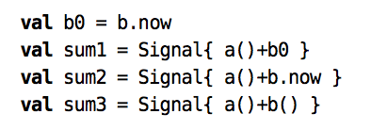
Signals
Used for data that varies over time
Signal.now creates a momentary dependency on the signal
Signal() is translated to Signal.apply() by the compiler and creates a dependency
These signal dependencies are further discussed in the section on the dependency stack

Slide 19
Other functions defined for Reactives
Halt
Suspends and disposes the current reactive
Par
Takes two branches, runs both of them until they suspend, finish or call join
Join
Halts execution of the current branch and joins the innermost enclosing ‘par’ expression
LoopEndUntil
Similar to loopUntil, but returns only after the body has finished evaluating
AbortOn
Similar to loopUntil, but evaluates body only once
<<
Defined only for events, emits the pulse given, overriding the current pilse
Update
Defined for signals only, sets current value to v, overwriting the current value

Slide 20
Reactive combinators
Collect
Emits events from a given stream after applying a function to them (if the function is defined for that event)
Map
Same function as map in functional programming, implemented using the collect combinator on the given function
Filter
Same function as filter in functional programming, implemented using the collect combinator using a function that maps the event to itself if the given filter function returns True when applied to the event
Switch
Creates a signal that behaves like a given signal until the receiver stream emits an event. Behaves like a second given signal after that

Slide 21
Reactive combinators
Take
Takes the first n events from a given stream
Drop
Drops the first n events from a given stream
Scan
Same function as accumulate in functional programming
Flatten
Used for nested events of events and events of signals. It returns a signal/event (implemented separately for the two) that behaves like the signal/event which is currently held by the outer event

Slide 22
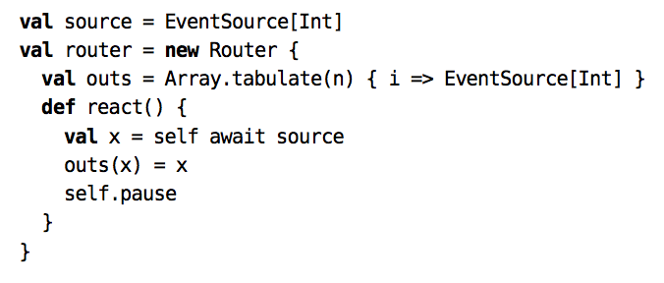
Routers
Signals/events have to be routed through the control hierarchy of the system
An O(n) way is to filter the event stream based on the controls
Scala.React allows for implementing routing as an O(1) operation

Slide 23
Implementation
Uses two components – a propagator and a scheduler
Scheduler initiates a turn when a request is available
Propagator collects all requests and validates all affected reactives
Then scheduler gains control again, performs some cleanup and waits for more requests

Slide 24
Change Propagation
All invalidated nodes are placed in a priority queue according to the topological order of the nodes
Propagator dequeues lowest node, validates it and puts all of its dependent nodes on the queue
This is repeated until the queue is empty
If the graph is correctly ordered, then there are no level mismatches, aka glitches
If not, then the procedure outlined in level mismatches is executed

Slide 25
Level Mismatches
If a node tries to access another node that is higher in the dependency graph, then a level mismatch exception is thrown
The propagator changes the node’s level so as to resolve the level mismatch, and then reinserts the node into the propagation queue since it needs to be validated again
All of the node’s dependents are also then hoisted
This can cause a signal to be evaluated twice
Thus, for reactives, the current continuation is captured before the level mismatch happens, and execution continues from this point when reevaluated later
This allows the use of local variables within reactive

Slide 26
Strict vs Lazy Nodes
Strict nodes are strictly validated when notified of a change
They do not propagate to their dependents if they do not need to emit
Lazy nodes are only validated when queried – these nodes do not accumulate state so this can work
They have to always notify their dependents, which is a disadvantage as compared to strict nodes
They are put onto the propagation queue since they do not need to be validated instantly, hence they have a performance advantage

Slide 27
Data-Flow DSL
Implemented using Scala’s continuations
Pause calls continueLater method
Halt calls shift method, passing a function that causes it to dispose the reactive
Await uses shiftAndContinue to add code which checks whether its input is emitting and if so, continues with the value from the input. Else, it subscribes the reactive to the input and suspends
More complicated control flow like loopEndUntil are implemented using par and join, which themselves use Scala continuation methods

Slide 28
Resource Management
An implementation where there is a strong reference from an event to the observer requires explicit memory management to dispose an observer before its dependencies are garbage collected
Thus weak references from the event to the observer are used instead
Once the client does not hold any references to an observer, it can be automatically garbage collected since there is only a weak reference to it from the event stream

Slide 29
Benefits of Scala.React
Works with general types
Glitch-free
Has higher-order features
Supports strict and lazy evaluation of nodes
No inversion of control
Binds lifetime of observers to an observing object
Reusable and uniform interfaces
No need to expose state
Can obtain a handle to a single feature without having to use multiple loosely coupled objects

Slide 30


